Slide 1
Bowtie
Caleb Lareau bit.ly/290bowtie

Slide 2
Overview
Who
What
When
Why
How
Secondary

Slide 3
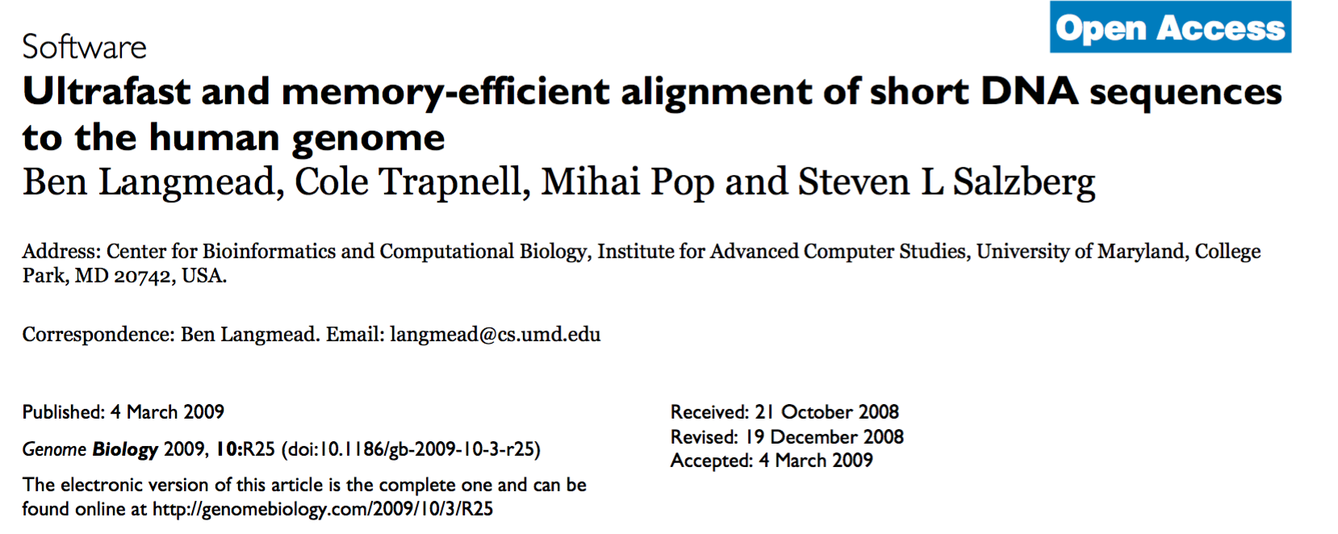
Who

Slide 4
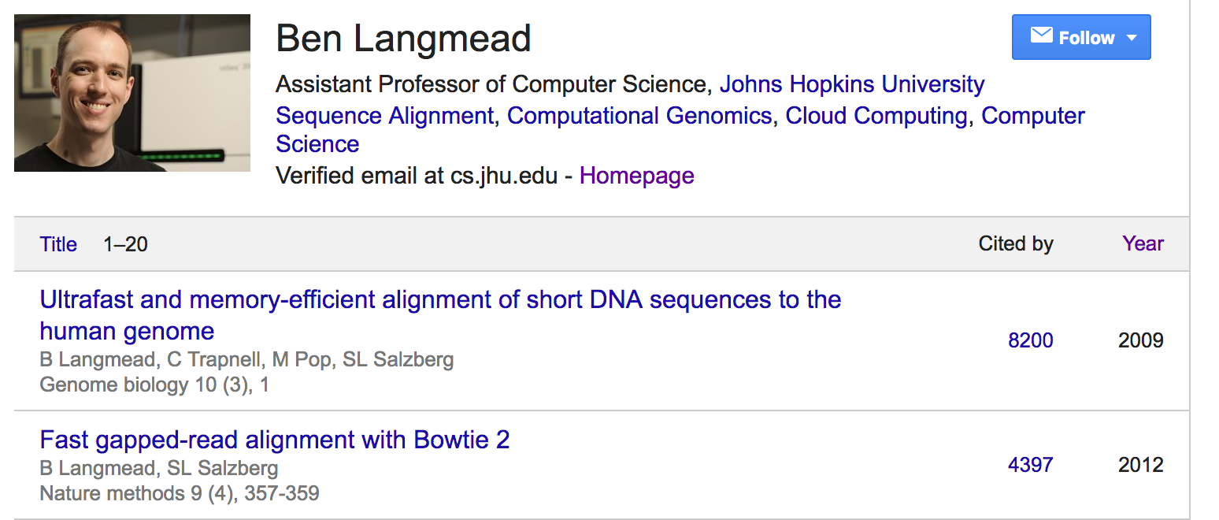
Who

Slide 5
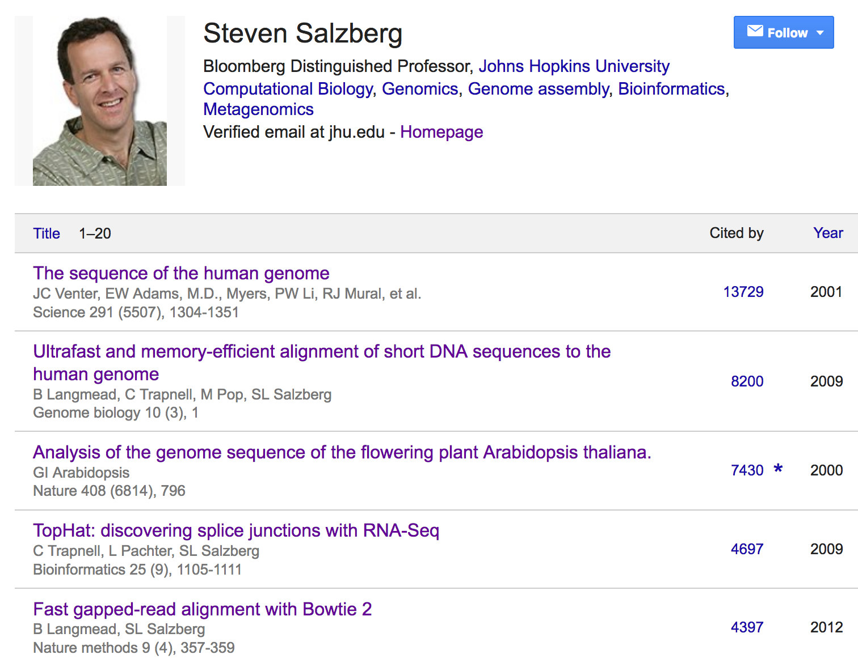
Who

Slide 6
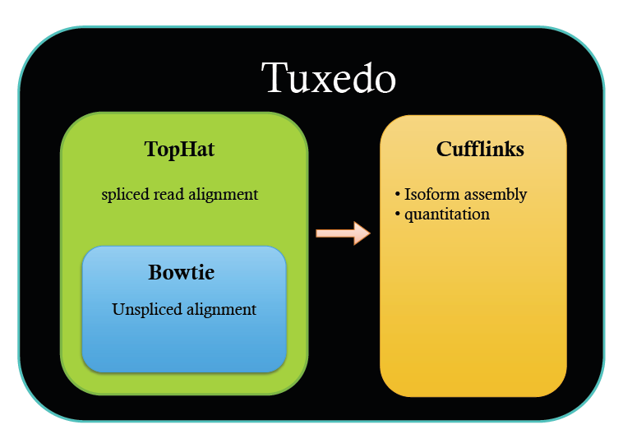


Slide 7
What
GAAATTTGC
GGAAATTTG
CGGAAATTT
CGGAAATTT
TCGGAAATT
CTATCGGAAA
CCTATCGGA
TTTGCGGT
GCCCTATCG
AAATTTGC
…CC
GCCCTATCG
AAATTTGC
ATAC…
…CCATAGGCTATATGCGCCCTATCGGCAATTTGCGGTATAC…
Genetics
Epigenetics
Transcriptomics

Slide 8
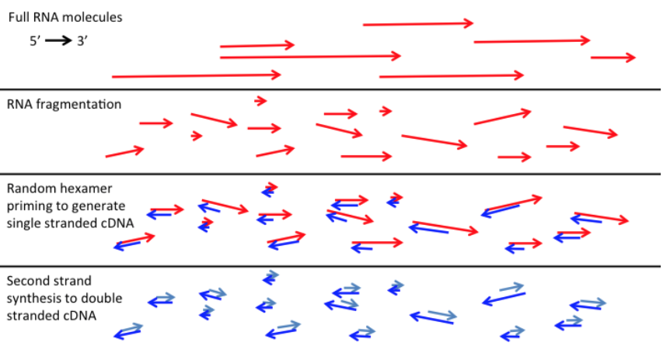

Slide 9
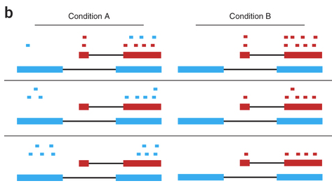

Slide 10
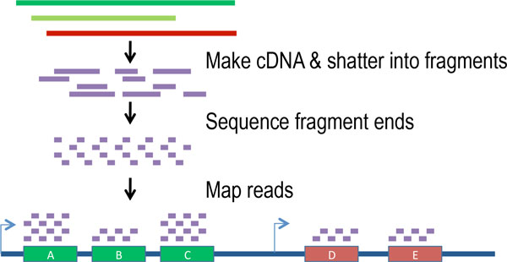

Slide 11
When

Slide 12
Before RNA-Seq…

Slide 13
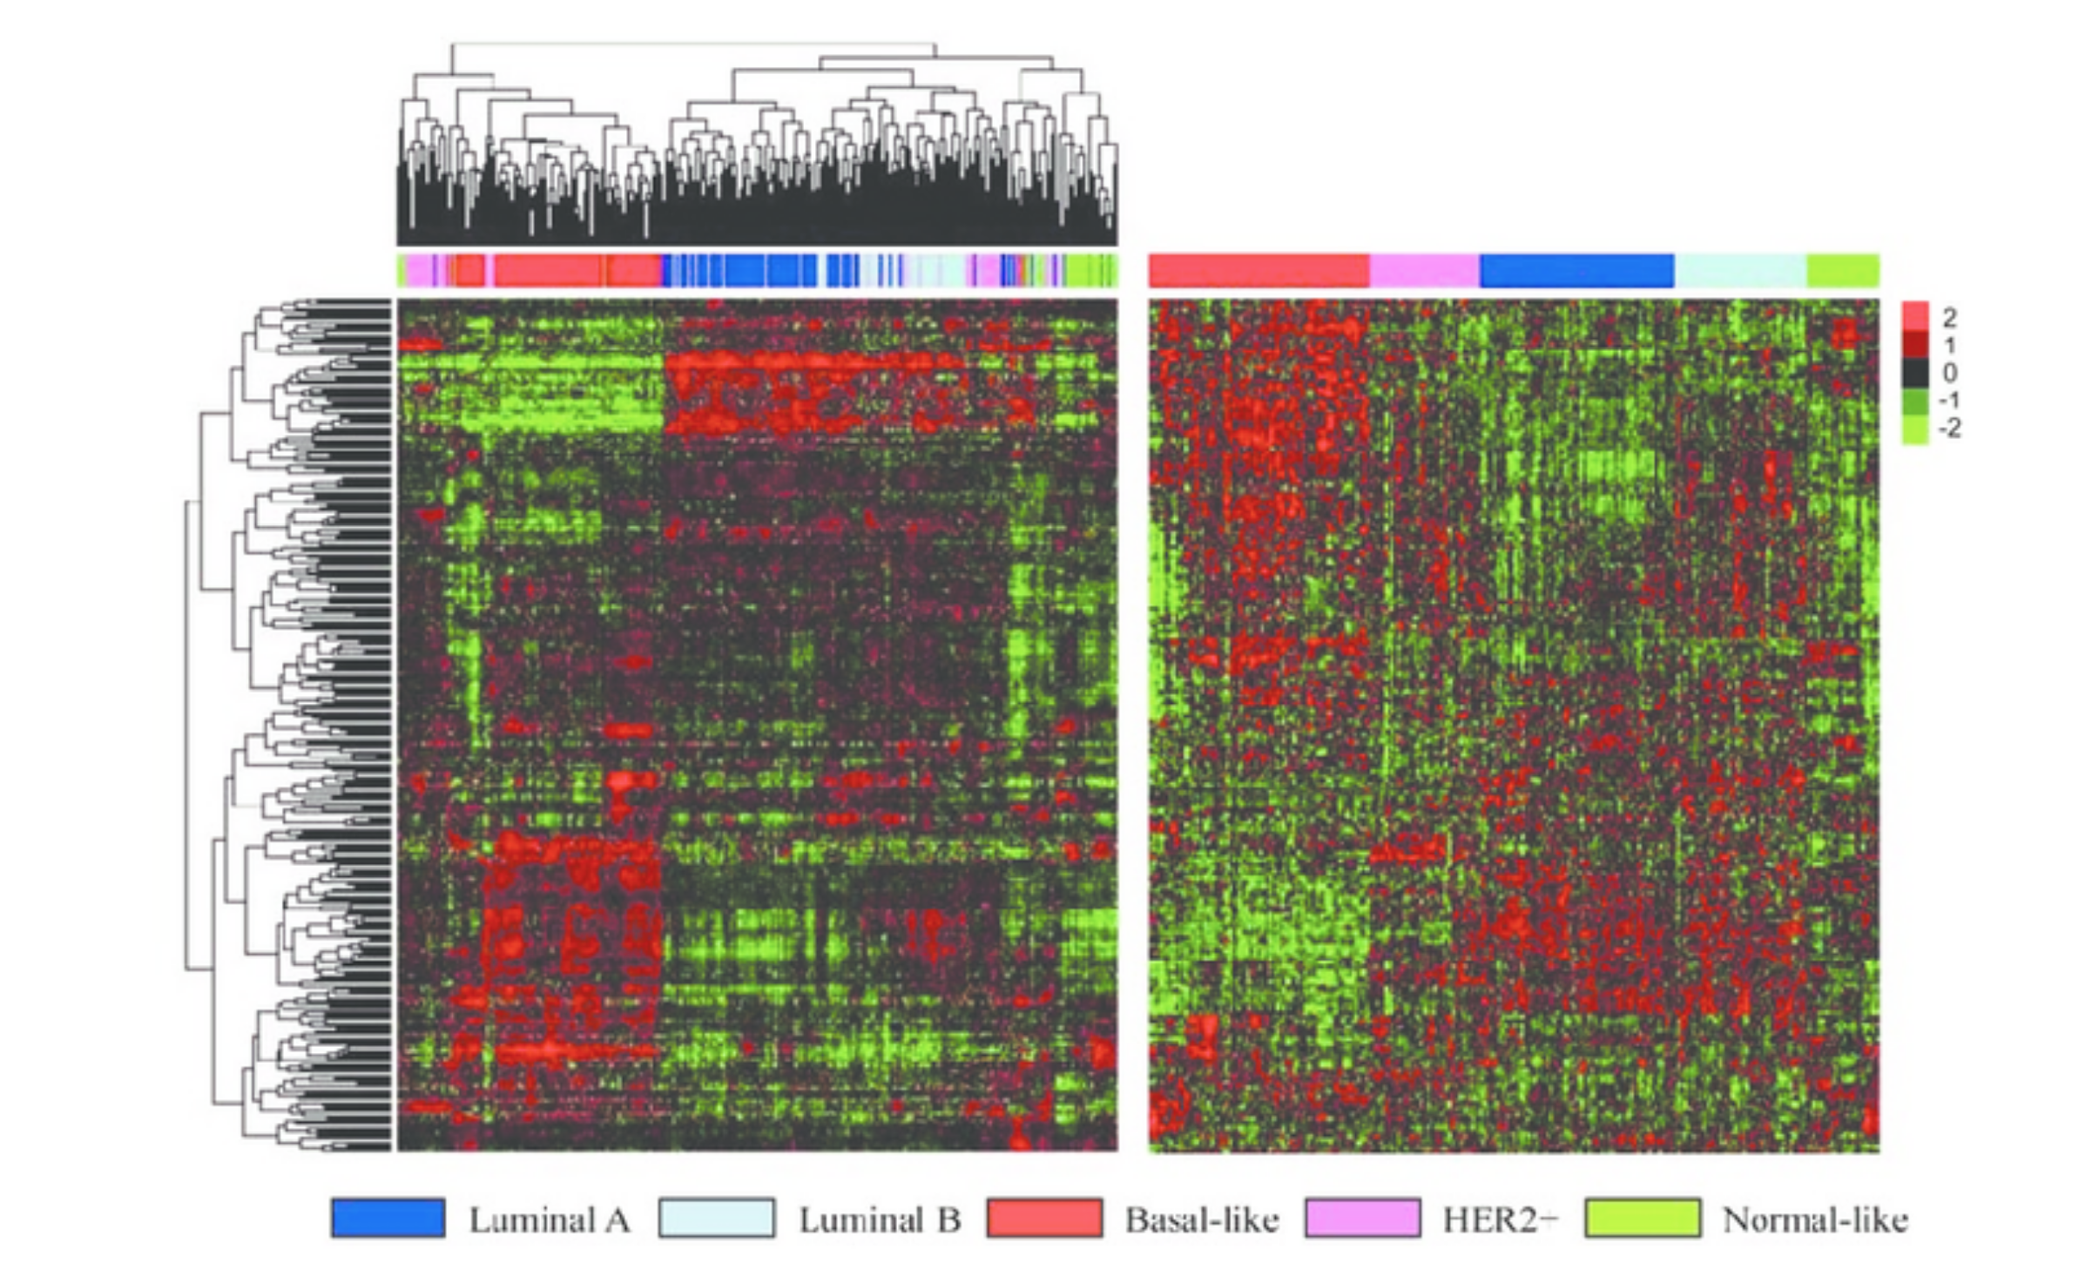

Slide 14
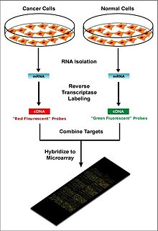
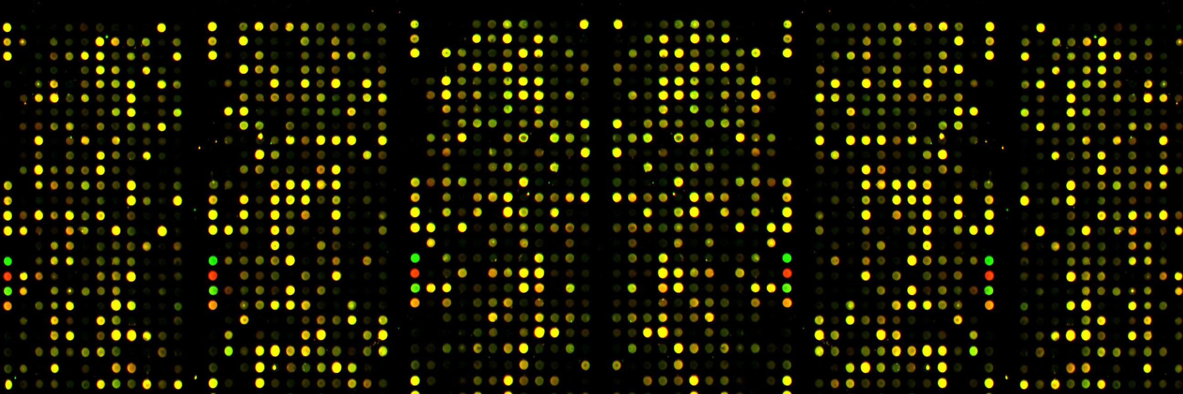

Slide 15
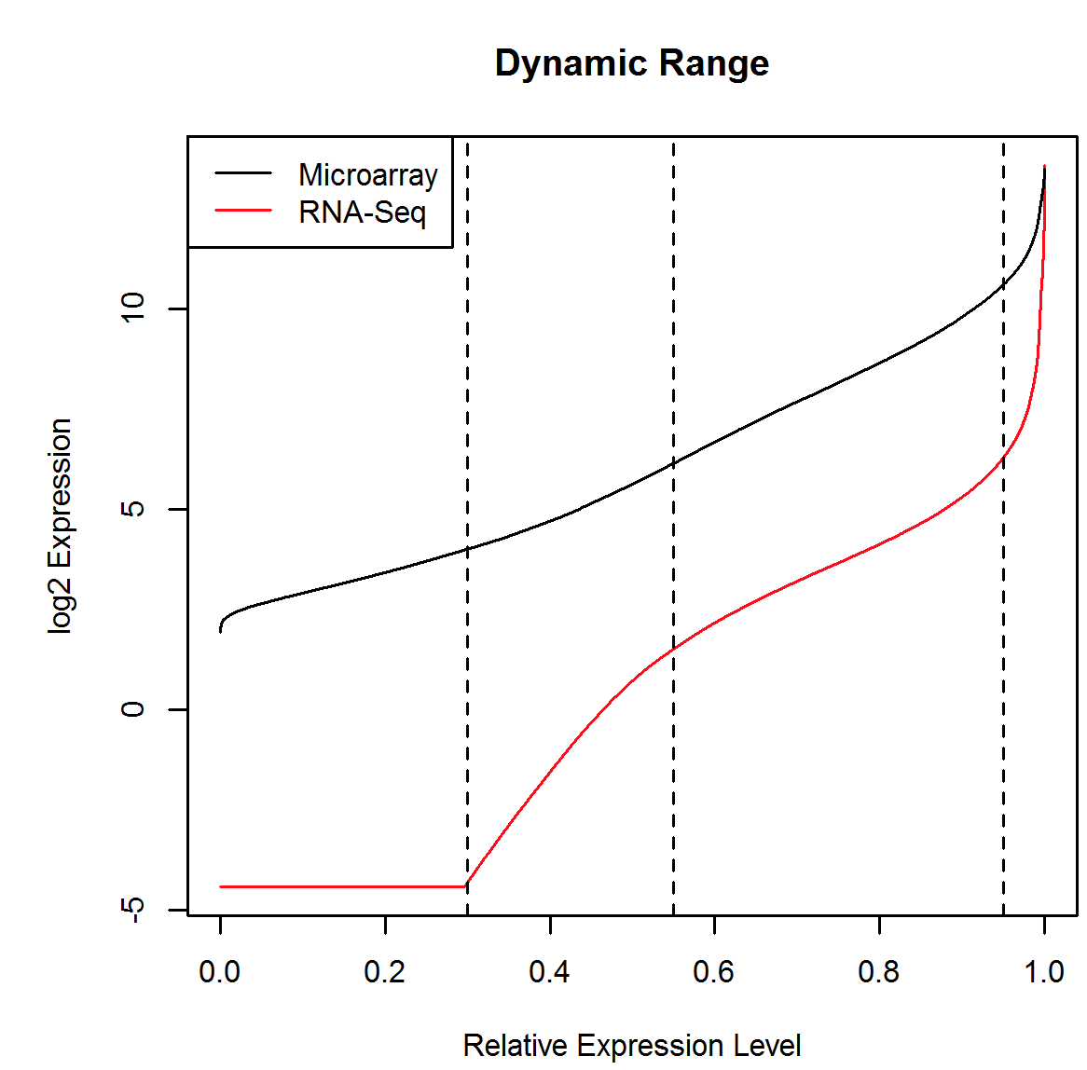
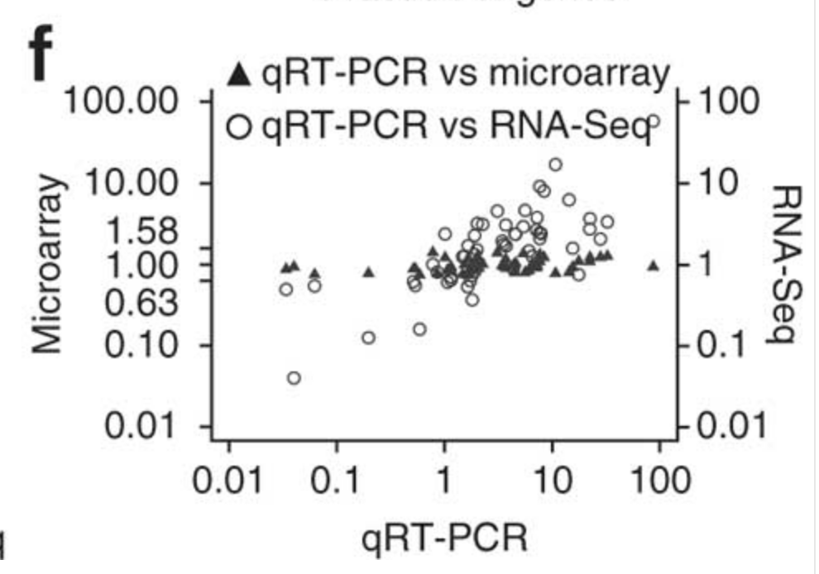
RNA-Seq vs. Microarray

Slide 16
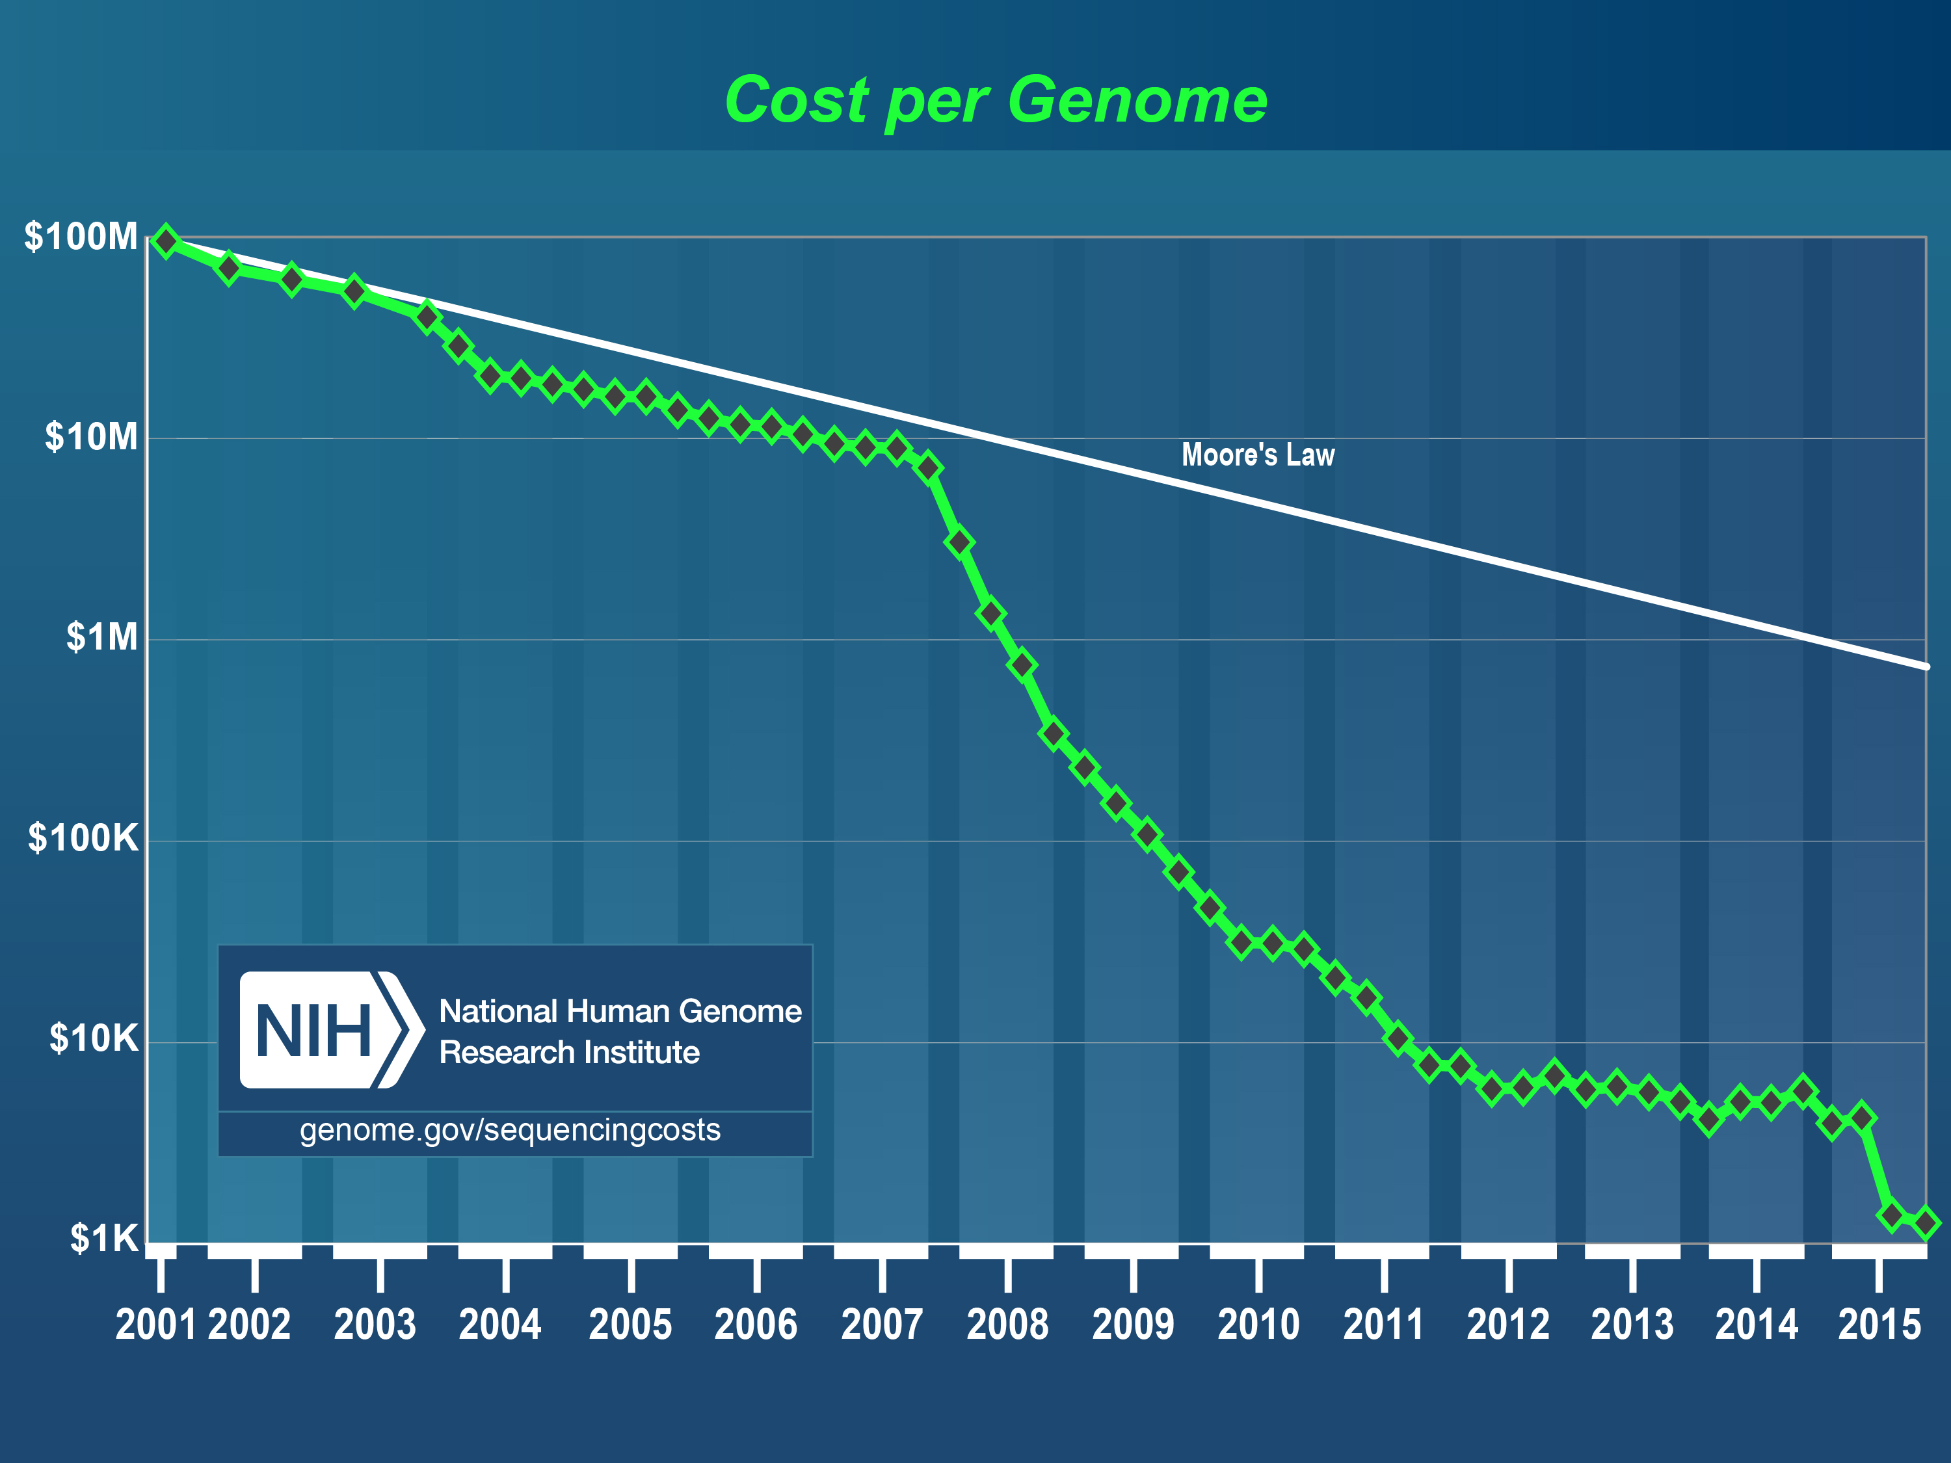

Slide 17
Summary: RNA-Seq > Microarray
Pros:
Accuracy
Novel transcript isoforms
Variant calls
Fusion gene identification
Cons:
More expensive; getting better

Slide 18
Why
Aligning DNA is the basis of all next-gen –omics analyses
Genetics
Epigenetics
Transcriptomics
Alignment is often the bottle neck

Slide 19
How

Slide 20
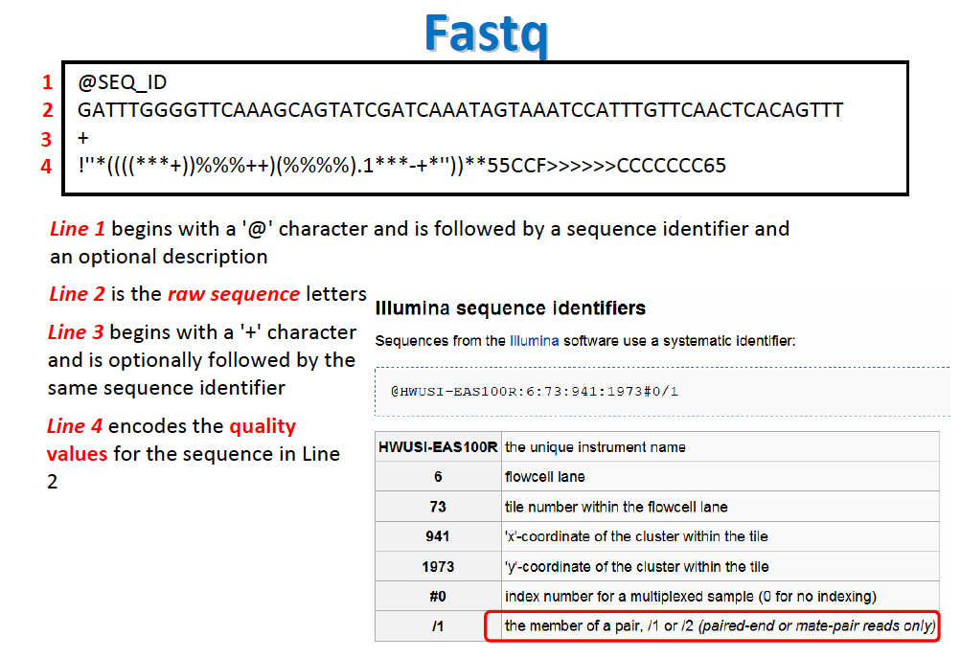
Data

Slide 21
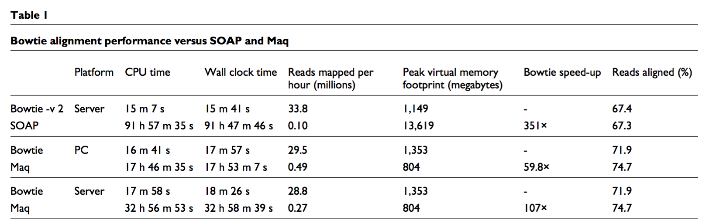
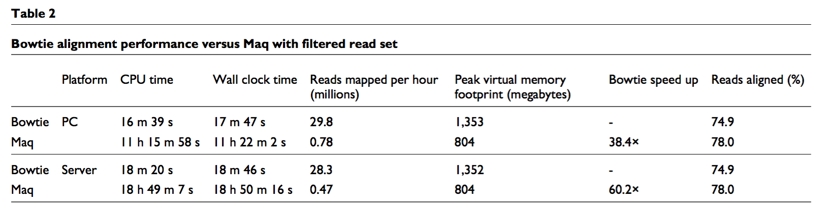
Tables

Slide 22
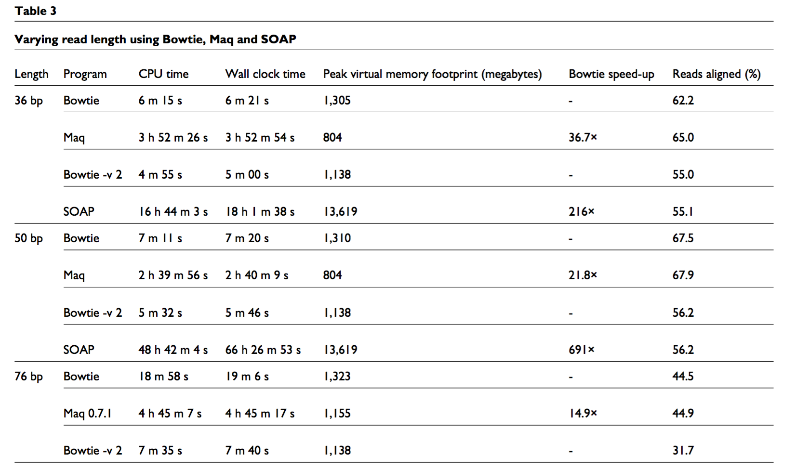
Tables

Slide 23
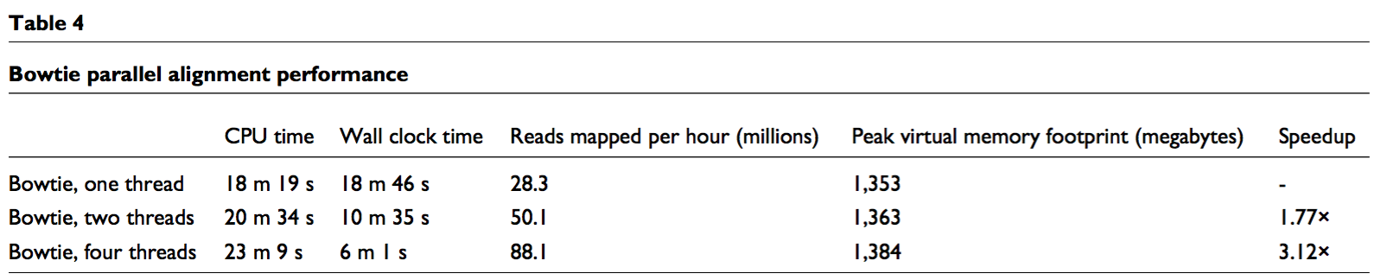
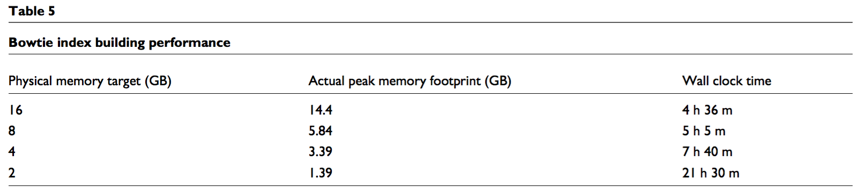
Tables

Slide 24
Better Explanation of Next Few Slides
https://www.youtube.com/watch?v=4n7NPk5lwbI
https://www.youtube.com/watch?v=hLsrPsFHPcQ

Slide 25
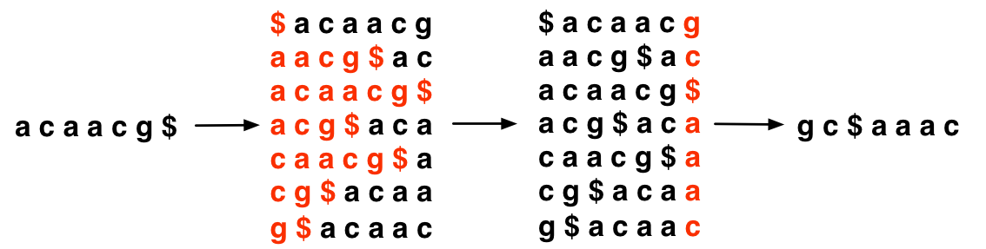
Burrows-Wheeler Transform
Once BWT(T) is built, all else shown here is discarded
Matrix will be shown for illustration only
T
BWT(T)
Burrows
Wheeler
Matrix
Last column
Burrows M, Wheeler DJ: A block sorting lossless data compression algorithm. Digital Equipment Corporation, Palo Alto, CA 1994, Technical Report 124; 1994

Slide 26
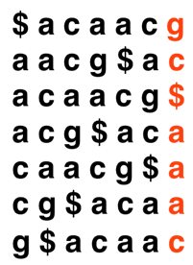

Burrows-Wheeler Transform
Property that makes BWT(T) reversible is “LF Mapping”
i^{th} occurrence of a character in Last column is same text occurrence as the i^{th} occurrence in First column
Rank: 2
BWT(T)
T
Rank: 2
Burrows Wheeler
Matrix

Slide 27
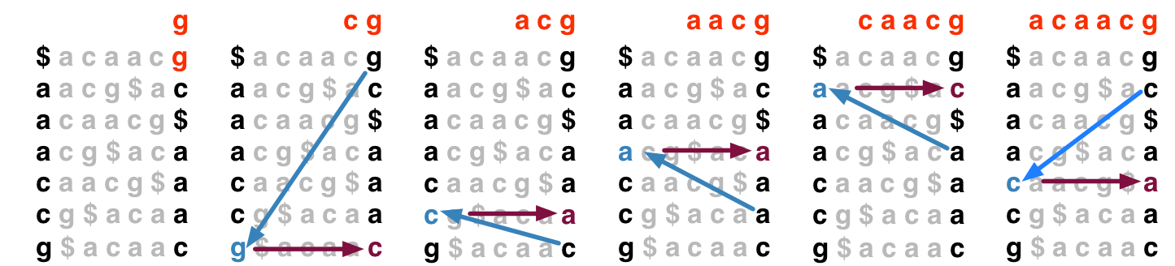
Burrows-Wheeler Transform
To recreate T from BWT(T), repeatedly apply rule:
T = BWT[ LF(i) ] + T; i = LF(i)
Where LF(i) maps row i to row whose first character corresponds to i’s last per LF Mapping
Could be called “unpermute” or “walk-left” algorithm
Final T

Slide 28
String Matching in Bowtie
https://www.youtube.com/watch?v=z5EDLODQPtg&feature=youtu.be&t=25s
A couple of subtle improvements (e.g. FM Index)

Slide 29
Short Read Alignment
The algorithm finds exact sequence matches quickly in small memory, but short read alignment demands more:
Allowances for mismatches
Consideration of quality values
Bowtie’s solution: backtracking quality-aware search

Slide 30
Backtracking
Consider an attempt to find Q = “agc” in T = “acaacg”:
Instead of giving up, try to “backtrack” to a previous position and try a different base
“g”
“c”
“gc” does not occur in the text

Slide 31
Backtracking
Bowtie’s –v <int> option allows alignments with up to <int> mismatches
Regardless of quality values
Max mismatches allowed: 3
* Li R et al: SOAP: short oligonucleotide alignment program. Bioinformatics 2008, 24(5):713-714.

Slide 32
Data

Slide 33
Qualities
When backtracking is necessary, Bowtie will backtrack to leftmost just-visited position with minimal quality
Greedy, depth-first, not optimal, but simple
Sequence:
G
C
C
A
T
A
C
G
G
A
T
T
A
G
C
C
Phred Quals:
40
40
35
40
40
40
40
30
30
20
15
15
40
40
40
40
(higher number = higher confidence)
G
C
C
A
T
A
C
G
G
A
C
T
A
G
C
C
40
40
35
40
40
40
40
30
30
20
15
15
40
40
40
40
G
C
C
A
T
A
C
G
G
G
C
T
A
G
C
C
40
40
35
40
40
40
40
30
30
20
15
15
40
40
40
40

Slide 34
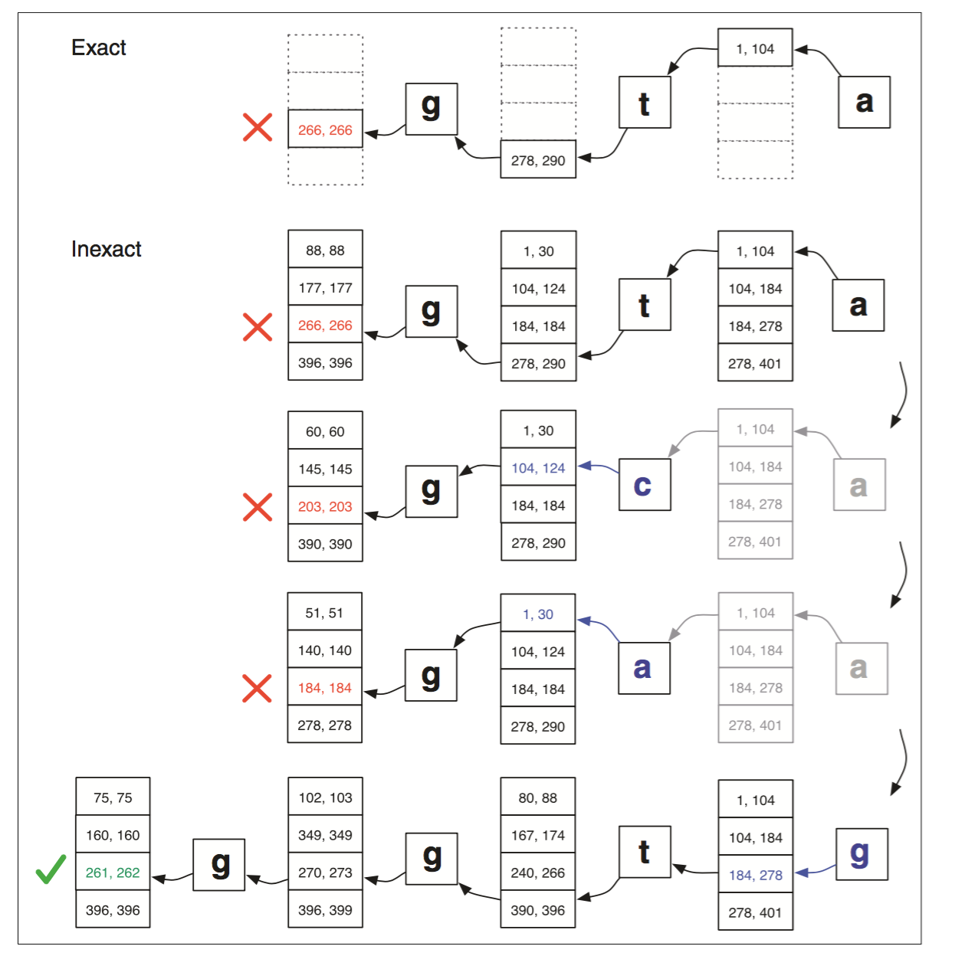

Slide 35
Loose ends…

Slide 37
Bowtie 2
Faster for reads longer than 50bp
Gapped alignments
Ambiguous characters (SNP mapping)

Slide 38
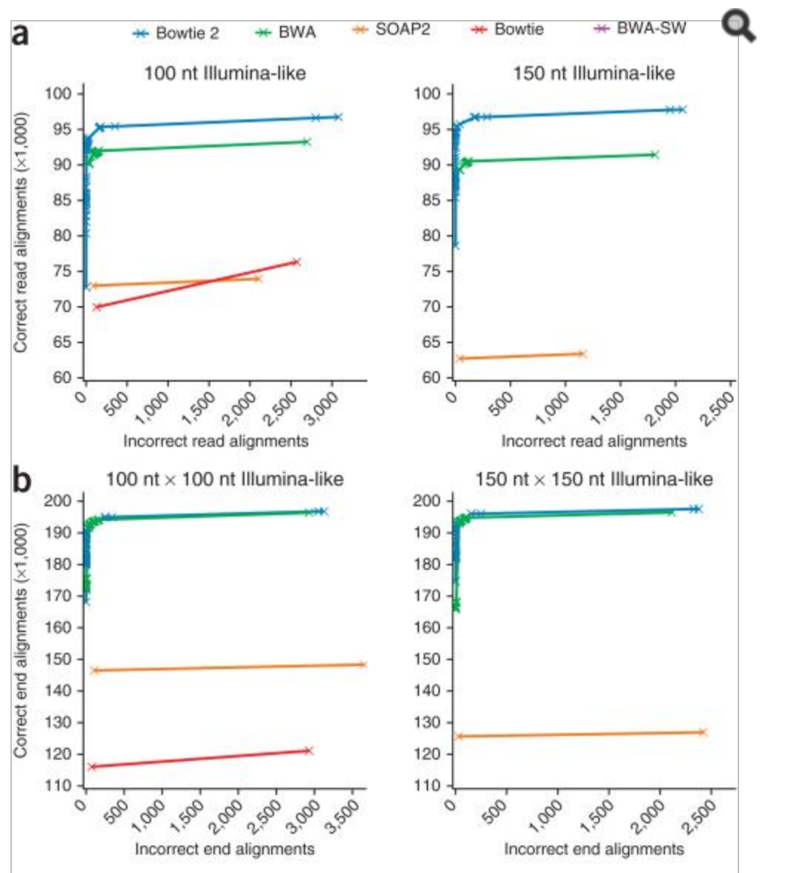

Slide 39
Strand Specific Matching
Common variants can bias read mapping
Facilitated through replacing the reference build with ‘N’
Other mechanisms: bias correction

Slide 40
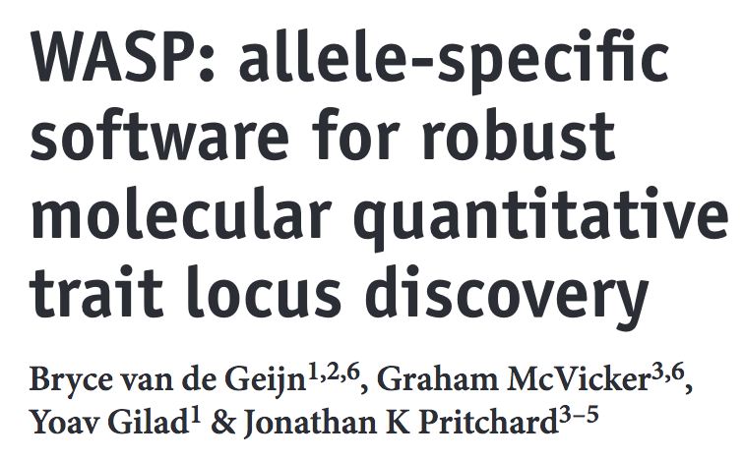
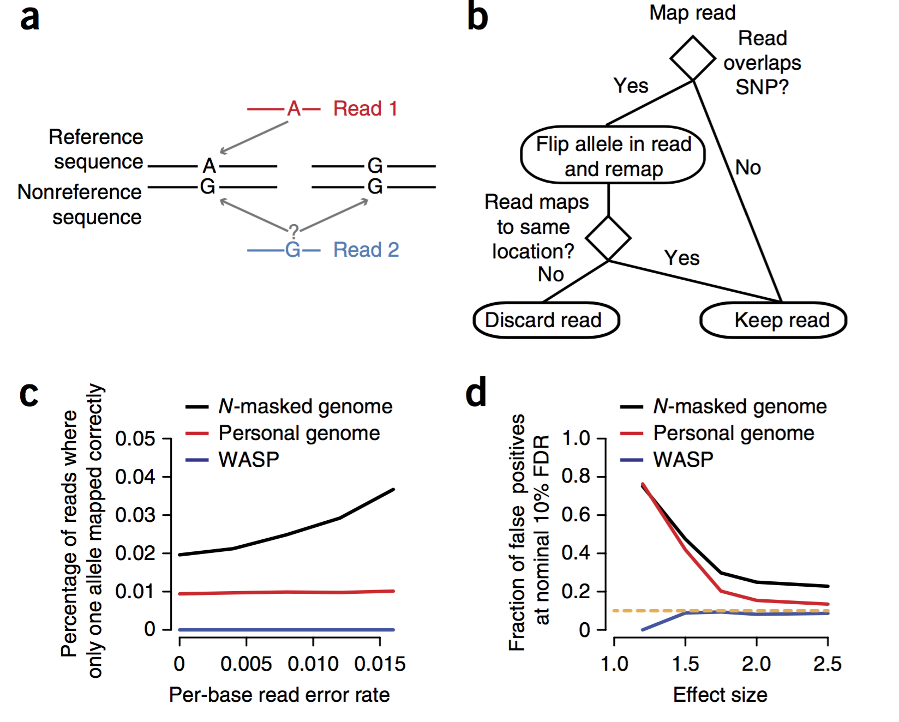
100 bp reads!

Slide 41
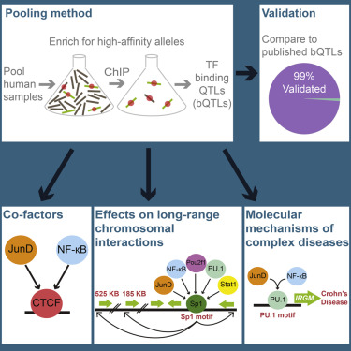
http://www.cell.com/cell/abstract/S0092-8674(16)30339-7

Slide 42
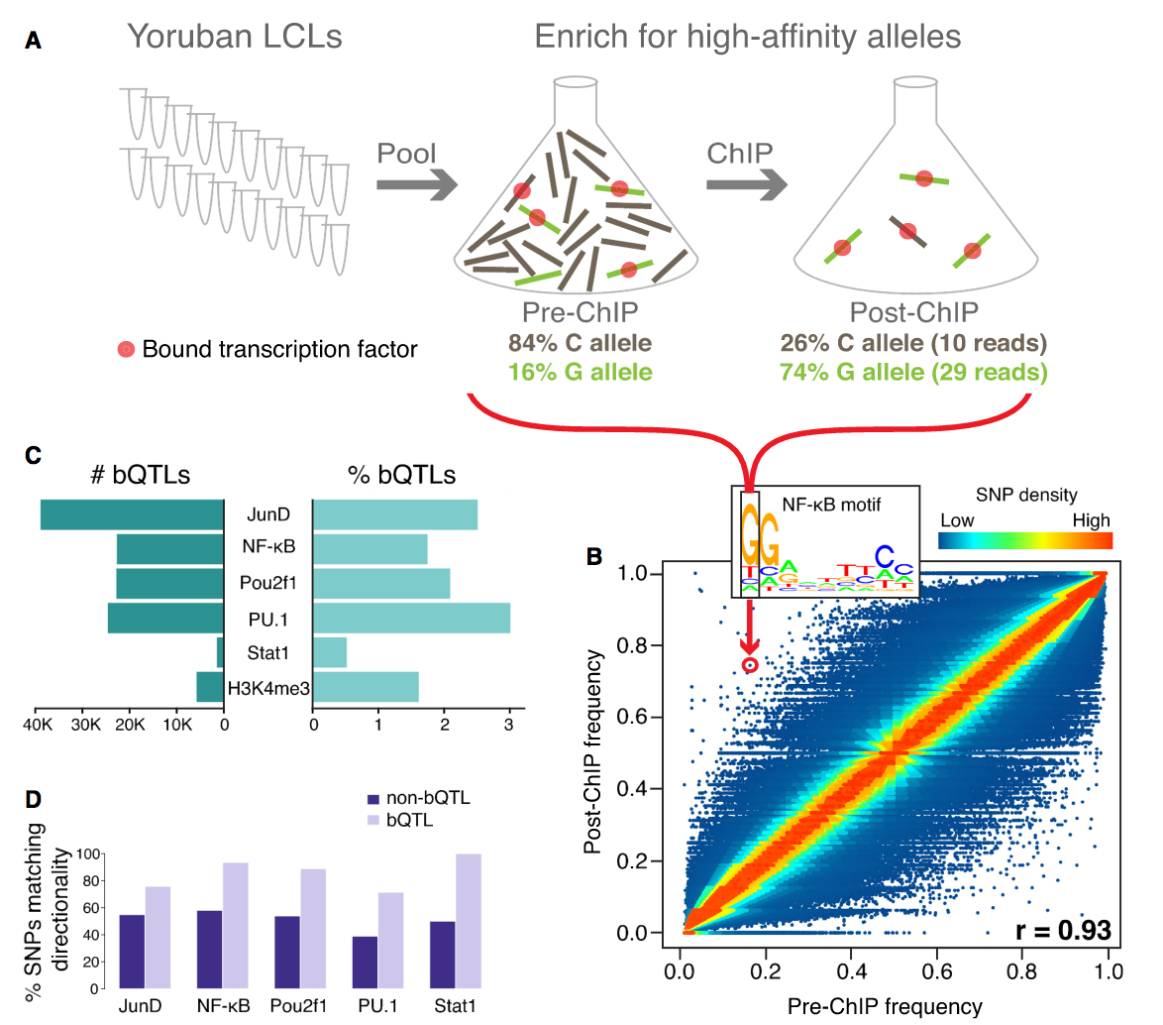

Slide 43
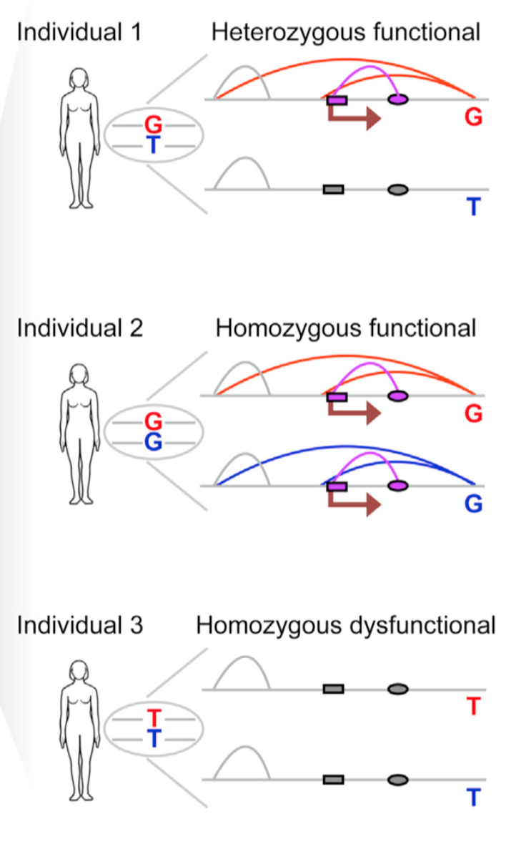
www.cell.com/cell/abstract/S0092-8674(15)01504-4

Slide 44
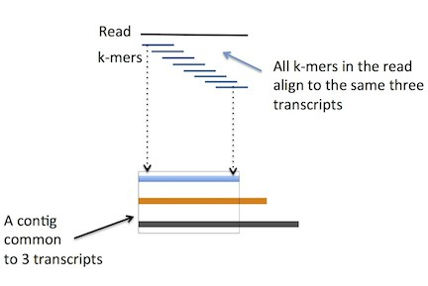
What’s next for alignment?
Pseudoalignment

Slide 45
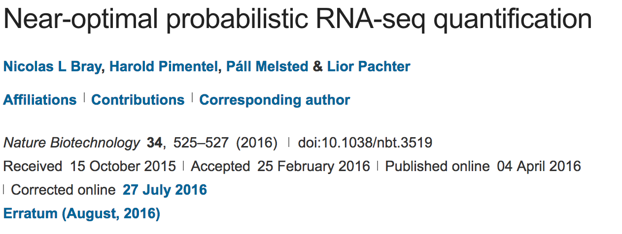

Slide 46
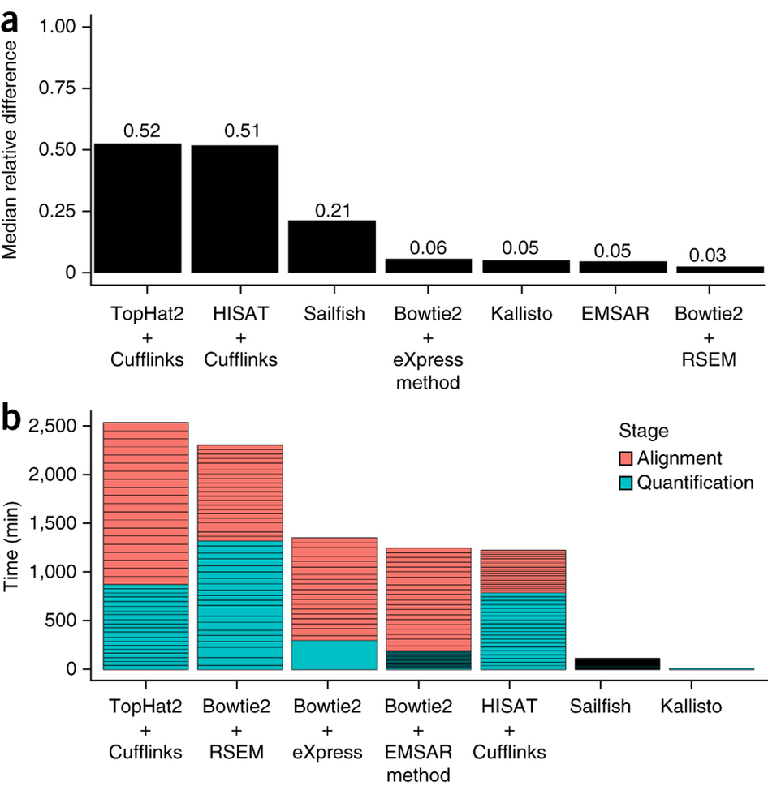

Slide 47
Video on Pseudoalignment
https://www.youtube.com/watch?v=94wphB3GKBM

Slide 48
References
Cedric Notredame’s presentation on short read alignment
Images from source manuscripts and blog posts

Slide 49
Discussion

